Slide 1
Approximation Algorithm
Travelling salesman problem

Slide 2
Travelling Salesman Problem solved using Naive approach and Dynamic Programming
Both of the solutions are infeasible. In fact, there is no polynomial time solution available for this problem as the problem is a known NP-Hard problem.
There are approximate algorithms to solve the problem though.
The approximate algorithms work only if the problem instance satisfies Triangle-Inequality.
Triangle-Inequality:
The least distant path to reach a vertex j from i is always to reach j directly from i, rather than through some other vertex k (or vertices),
i.e., dis(i, j) is always less than or equal to dis(i, k) + dist(k, j). The Triangle-Inequality holds in many practical situations.

Slide 3
When the cost function satisfies the triangle inequality, we can design an approximate algorithm for TSP that returns a tour whose cost is never more than twice the cost of an optimal tour.
The idea is to use Minimum Spanning Tree (MST). Following is the MST based algorithm.
Algorithm:
Let 1 be the starting and ending point for salesman.
Construct MST from with 1 as root using Prim’s Algorithm.
List vertices visited in preorder walk of the constructed MST and add 1 at the end.

Slide 4
What is a Minimum Spanning Tree?
A minimum spanning tree is a special kind of tree that minimizes the lengths (or “weights”) of the edges of the tree. An example is a cable company wanting to lay line to multiple neighborhoods; by minimizing the amount of cable laid, the cable company will save money.
A tree has one path joins any two vertices. A spanning tree of a graph is a tree that:
-Contains all the original graph’s vertices.
- Reaches out to (spans) all vertices.

Slide 5
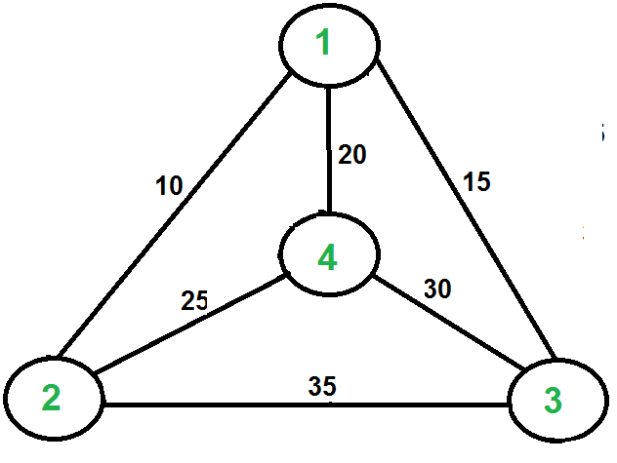
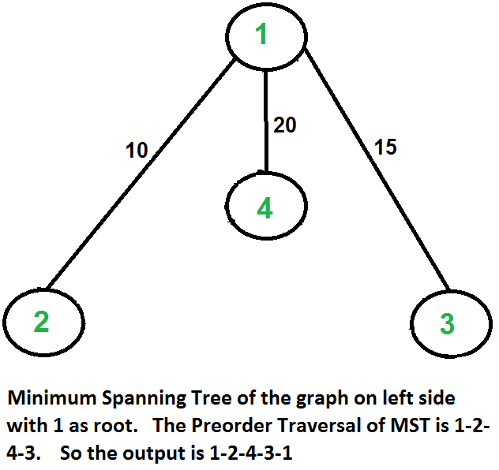
Let us consider the following example. The first diagram is the given graph. The second diagram shows MST constructed with 1 as root. The preorder traversal of MST is 1-2-4-3. Adding 1 at the end gives 1-2-4-3-1 which is the output of this algorithm.

Slide 6
In this case, the approximate algorithm produces the optimal tour, but it may not produce optimal tour in all cases.
How is this algorithm 2-approximate?
The cost of the output produced by the above algorithm is never more than twice the cost of best possible output. Let us see how is this guaranteed by the above algorithm.
Let us define a term full walk to understand this. A full walk is lists all vertices when they are first visited in preorder, it also visit vertices when they are returning after a subtree is visited in preorder. The full walk of above tree would be 1-2-1-4-1-3-1.

Slide 7
Following are some important facts that prove the 2-approximateness.
The cost of best possible Travelling Salesman tour is never less than the cost of MST. (The definition of MST says, it is a minimum cost tree that connects all vertices).
The total cost of full walk is at most twice the cost of MST (Every edge of MST is visited at-most twice)
The output of the above algorithm is less than the cost of full walk.
In above algorithm, we print preorder walk as output. In preorder walk, two or more edges of full walk are replaced with a single edge. For example, 2-1 and 1-4 are replaced by 1 edge 2-4. So if the graph follows triangle inequality, then this is always true.

Slide 8
From the above three statements, we can conclude that the cost of output produced by the approximate algorithm is never more than twice the cost of best possible solution.
We have discussed a very simple 2-approximate algorithm for the travelling salesman problem. There are other better approximate algorithms for the problem. For example Christof ides algorithm is 1.5 approximate algorithm.

Slide 9
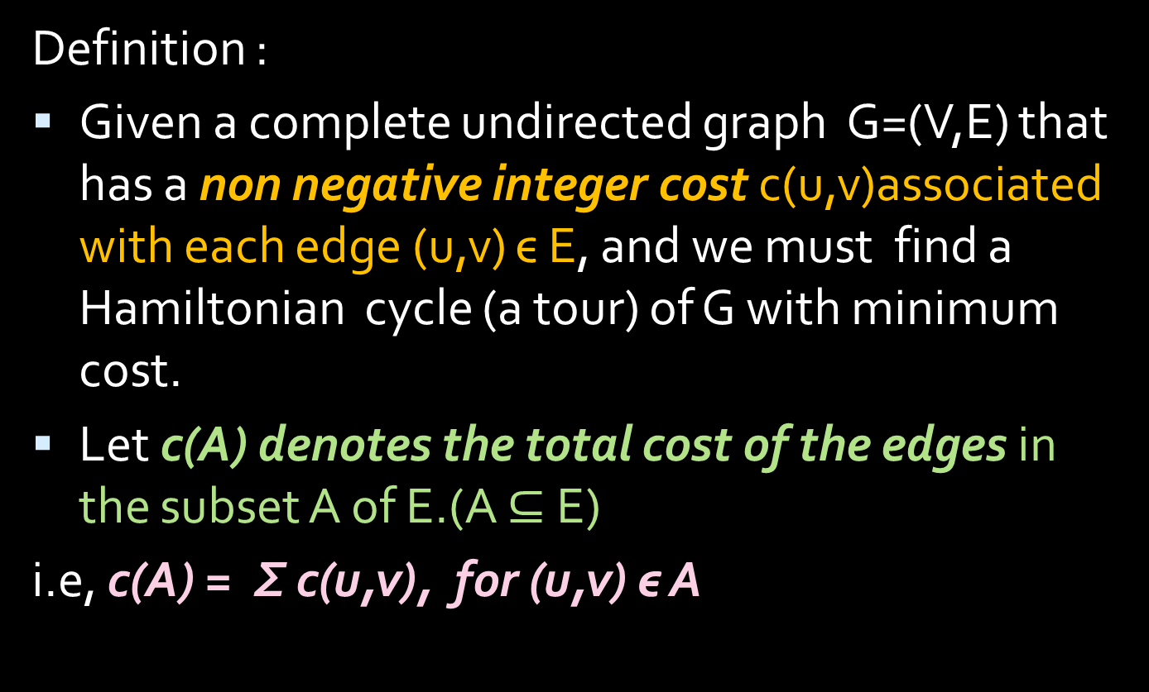
Travelling Salesman Problem
Definition :
Given a complete undirected graph G=(V,E) that has a non negative integer cost c(u,v)associated with each edge (u,v) ϵ E, and we must find a Hamiltonian cycle (a tour) of G with minimum cost.
Let c(A) denotes the total cost of the edges in the subset A of E.(A $⊆$ E)
i.e, c(A) = Σ c(u,v), for (u,v) ϵ A

Slide 10
What is a Minimum Spanning Tree?
Let G = (V, E) be a simple, connected, undirected graph that is not edge-weighted.
A spanning tree of G is a free tree (i.e., a tree with no root) with | V | -1 edges that connects all the vertices of the graph.
Thus a minimum spanning tree T = (V’, E’) for G is a subgraph of G with the following properties:
V’ = V
T is connected
T is acyclic ( → |E’| = |V| - 1) {An acyclic graph is a graph having no graph cycles. A connected acyclic graph is known as a tree, and possibly disconnected }
A spanning tree is called a tree because every acyclic undirected graph can be viewed as a general, unordered tree.
Because the edges are undirected, any vertex may be chosen to serve as the root of the tree.

Slide 11
TSP
Instance: a complete weighted undirected graph G=(V,E) (all weights are non-negative).
Problem: to find a Hamiltonian cycle of minimal cost.
3
1
2
10
3
4
5

Slide 12
TSP- TRIANGULAR INEQUALITY
Cutting out an intermediate stop never increases the cost.
This notion by saying the cost function c satisfies the triangular inequality if for all vertices u,v,w ϵ V,
c(u,w) <= c(u,v)+ c(v,w)
E.g.:
If all the edges are defined as the distance on a 2D map, the triangle inequality is true
For the TSPs where the triangle inequality is true:
There is a 2-approximation polynomial time algorithm

Slide 13
The Triangle Inequality
Definition: We’ll say the cost function c satisfies the triangle inequality, if
∀u,v,w∈V : c(u,v)+c(v,w)≥c(u,w)

Slide 14
TSP
Travelling sales man problem is NP Complete (using cost function to show that triangular inequality satisfies).
But it is unlikely that we find a polynomial time algorithm for solving this problem exactly. So we look for good approximation algorithm .
We go for a 2 – approximation algorithm with triangular inequality.
NOTE: If triangular inequality is not used , then a constant approx/ algorithm does not exist unless P=NP

Slide 15
What is a Minimum Spanning Tree?
A minimum spanning tree is a special kind of tree that minimizes the lengths (or “weights”) of the edges of the tree.
An example is a cable company wanting to lay line to multiple neighborhoods; by minimizing the amount of cable laid, the cable company will save money.
A tree has one path joins any two vertices. A spanning tree of a graph is a tree that:
-Contains all the original graph’s vertices.
- Reaches out to (spans) all vertices.

Slide 16
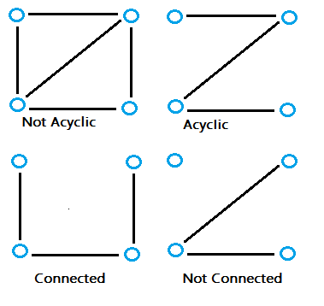
Is acyclic. In other words, the graph doesn’t have any nodes which loop back to itself.

Slide 17
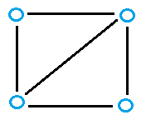
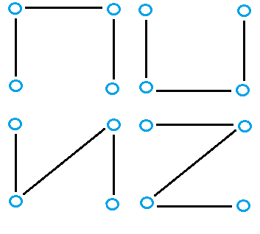
Even the simplest of graphs can contain many spanning trees. For example, the following graph:
has many possibilities for spanning trees, including:

Slide 18
TSP
STEPS:
Compute a MINIMUMSPANNING TREE T, whose weight is lower bound on the length of optimal travelling salesman tour(H*).(i.e, c(T) <= c(H*).)
Use the MST to create a tour whose cost no more than twice that of minimum spanning tree’s weight ,as long as the cost function satisfies the triangular inequality.
The following algorithm implements this approach , calling the MST-PRIM as subroutine.

Slide 19
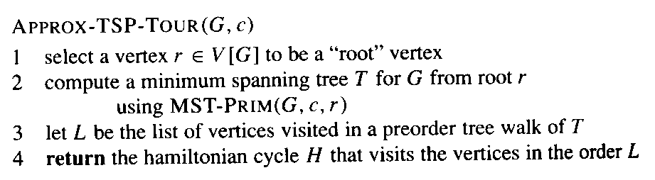
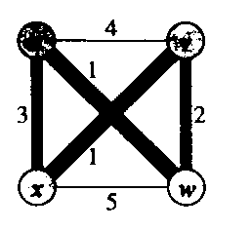
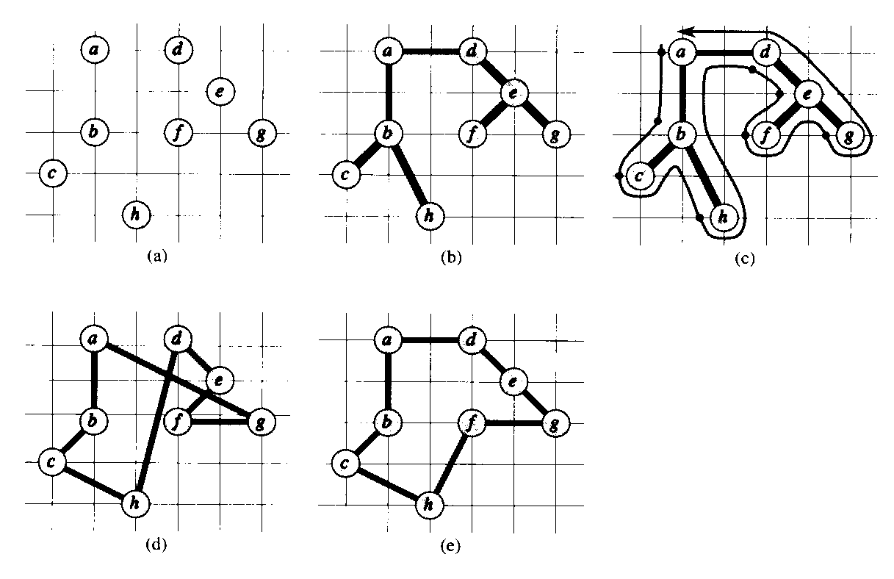
TSP with Triangle Inequality
u
v
5
3
3
5
x
w
4
Cost Function Satisfies
“full walk” = abcbhbadefegeda
Triangle Inequality
final approximate tour
optimal tour
source: 91.503 textbook Cormen et al.

Slide 21
The operation of TSP_TOUR
a) The given set of points , which lie on vertices of an integer grid. –(Euclidean distance is used as the cost function between two points).(fig-a)
b) A MST ‘T’ of those points as computed by MST_PRIM ,with vertex ‘a’ as the root . The vertices happen to be labeled in such a way that they are added to the main tree by MST_PRIM in alphabetical order. (fig b)
c) A walk of T, starting at a . A full walk of the tree visits the vertex in the order a,b,c,b,h,b,a,d,e,f,e,g,e,d,a. ( In Full walk every edge of E is traversed Twice)
A PRE order walk of T lists a vertex just when it is first encountered , i.e, a,b,c,h,d,e,f,g.(fig-c)
d) A tour of the vertices obtained by visiting the vertices in the order given by the preorder walk. This the tour H returned by APPROX_TSP_TOUR. (fig-d)
e) An optimal tour H* for the given set of vertices . (fig-e)
Running time of the APPROX_TSP_TOUR is O(V²).

Slide 22
TSP
NOW “To show that if the cost function for an instance of the travelling salesman problem satisfies the triangular inequality, then APPROX_TSP_TOUR returns a tour H whose cost is not more than twice the cost of an optimal tour i.e,2 c(H*).
To Prove:
i.e, c(H) <= 2 c(H*).

Slide 23
THEOREM - 35.2 APPROX_TSP_TOUR is polynomial time 2 approximation algorithm for the TSP with triangular inequality
Proof : APPROX_TSP_TOUR runs in polynomial time (proved)
Let H* denote an optimal tour for the given set of vertices..
Since we obtain a spanning tree by deleting any edge from a tour, the weight of the minimum spanning tree T is lower bound on the cost of an optimal tour , that is
c(T) <= c(H*). -------------------------------→ (1)
A full walk of T lists the vertices when they are first visited and also whenever they are returned to after a visit to a subtree . Let us call this walk as W (order a,b,c,b,h,b,a,d,e,f,e,g,e,d,a. by example )
Since the full walk traverse every edge of T exactly twice,we have
c(W) = 2c(T).--------------------------------→ (2)
From (1) and (2) ,we’ve, c(W) <=2 c(H*).-------------------→(3)
So the cost of W is within a factor of the cost of an optimal tour. BUT W is not a tour, since it visits some vertices more than once.

Slide 24
Contnd……………………….
W is not atour,since it visits vertices more than once.
By the triangular inequality, we can delete a visit to any vertex from W and the cost does not increase.
ie., if vertex v deleted from W between visits u to,w , the resulting ordering specifies going directly from u to w .
By repeatedly applying this operation , we remove from W all but the first visit to each vertex. (a,b,c,h,d,e,f,g – pre order walk by example)
Now Let H be the cycle corresponding to this preorder walk .
It is a Hamiltonian cycle ,since every vertex is visited exactly once and it is the cycle computed by APPRX_TSP_TOUR.
Since H is obtained by deleting vertices from the FULL WAILK W, we ‘ve ,
c(H)<= c(W) --------------------------------→ (4)
From (3) and (4) , it shows that
c(H) <= 2 c(H*).
Which completes the proof

